Slide 1
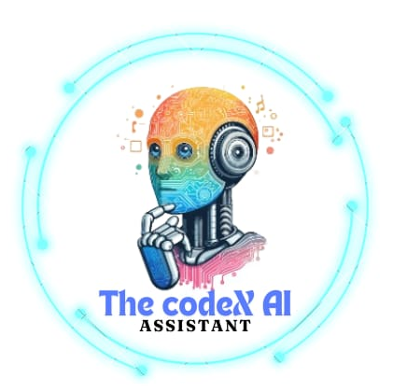
AI DESKTOP
VIRTUAL ASSISTANT Project
Submitted by:
Anish kumar (2247341)
Sanish kumar (2246004)
Uma Shankar
Zara (2450881)
Rima (2449302)

Slide 2
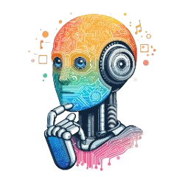
Content
Detailed Project Overview
Introduction to AI Assistant
Objectives of the Project
Technology Used
APIs
System Architecture
External API Integration
Key Features
Workflow of AI Assistant
Real-Time Performance and Scalability
Use Case
Future Enhancements
Conclusion

Slide 3
Introduction to AI Assistant
What is an AI Assistant?
A software agent that can perform tasks or services based on user input, commands, or data.
Examples:
Siri (Apple), Alexa (Amazon), Google Assistant

Slide 4
Objectives of the Project
Develop an Intelligent Conversational Agent:
Build an AI assistant that can engage in natural, human-like conversations using advanced Natural Language Processing (NLP) techniques.
Enable the assistant to understand and respond to both text-based and potentially voice-based commands.
Integrate External APIs for Real-Time Data Access:
Incorporate APIs (such as Google Maps, OpenWeather, and others) to provide real-time information like weather updates, directions, and location-based services.
Ensure seamless communication between the AI assistant and external APIs to enhance its functional range.
Context-Aware Interaction:
Implement context management to enable the assistant to understand multi-turn conversations.
Allow the assistant to maintain conversation flow and remember key details for improved personalized assistance.

Slide 5
Technology Used
Graphical User Interface (GUI):
Tkinter: A standard Python library for creating graphical user interfaces. It will be used to design and implement the UI of the AI assistant.
Image Processing:
PIL (Python Imaging Library):
Used for opening, manipulating, and saving image files. The Image and ImageTk modules from PIL will handle image-related tasks in the project.
Speech Recognition:
spech_to_text: This module will be utilized for converting spoken language into text, enabling voice input functionality for the AI assistant.
Action Handling:
action: A custom or predefined module to manage and execute various actions based on user inputs or commands.

Slide 6
APIs:
1. Google Maps API
2. OpenWeather API
System Architecture
Diagram: AI Assistant System Flow (Data Input → NLP Processing → API Integration → Response Generation)
Components:
User Input
API Communication
Response Generation

Slide 7
External API Integration
Purpose: Extend the assistant’s capabilities by integrating third-party services.
APIs Used:
Weather: Fetch real-time weather updates.
Maps: Provide location-based services like navigation, directions, and geocoding.

Slide 8
Key Features
Conversational Abilities: The assistant can understand and respond to queries.
Personalized Assistance: It can remember user preferences.
API Integration: Weather updates, directions, and more.
Voice Interaction: If applicable (using text-to-speech or voice commands).

Slide 9
Workflow of AI Assistant
Step-by-Step Flow:
User asks a question.
AI assistant processes the query using NLP.
If external data is needed (e.g., weather, location), it calls relevant APIs.
AI assistant generates and delivers the response.

Slide 10
Understanding Natural Language
Challenge:
Context and Ambiguity: Natural language can be ambiguous and context-dependent, making it difficult for the AI to accurately interpret user intent.
Solution:
Context Management: Implement context-aware systems that track and manage the context of conversations. Use techniques like Named Entity Recognition (NER) and contextual embeddings (e.g., BERT or GPT) to better understand user intent.
Training Data:
Use a diverse dataset to train the NLP model, incorporating various phrasings and contexts to improve accuracy.

Slide 11
Real-Time Performance and Scalability
Challenge:
Response Time: Ensuring the AI assistant responds quickly to user queries, especially when integrated with external APIs.
Scalability: Handling a growing number of users and interactions without performance degradation.
Solution:
Optimized Code and Algorithms: Use efficient algorithms and optimize code to reduce latency. Implement caching mechanisms for frequently accessed data.
Load Balancing: Utilize load balancers and scalable cloud services (e.g., AWS, Google Cloud) to handle high traffic and ensure consistent performance.

Slide 12
Use Cases
Weather Assistant: Provide real-time weather updates.
Map Navigation: Guide users with directions using Maps API.
Customer Support: Answer user queries for businesses.
Reminders and Scheduling: Personal productivity tools.

Slide 13
Demo (Optional)
Live Demo of AI Assistant:
Show how it responds to queries.
Demonstrate API integration with a real-time example (e.g., weather updates or directions).

Slide 14
Future Enhancements
1. Voice Recognition Integration
Objective: Incorporate voice-to-text and text-to-voice capabilities to enable hands-free interaction.
Implementation:
Speech Recognition: Integrate with advanced speech recognition APIs (e.g., Google Cloud Speech-to-Text, Microsoft Azure Speech).
Text-to-Speech (TTS): Use TTS libraries (e.g., Google Text-to-Speech, Amazon Polly) to convert responses into natural-sounding speech.
Benefit: Enhances accessibility and convenience, allowing users to interact with the assistant using voice commands.

Slide 15
2. Multilingual Support
Objective: Expand the AI assistant’s ability to understand and respond in multiple languages.
Implementation:
Language Models: Train or integrate multilingual NLP models that can process and generate responses in various languages.
Localization: Adapt the interface and responses to different cultural contexts and language nuances.
Benefit: Broadens the user base by making the assistant accessible to non-English speakers and global audiences.

Slide 16
3. Advanced Context Management
Objective: Improve the assistant’s ability to maintain and utilize context across longer and more complex interactions.
Implementation:
Contextual Memory: Develop mechanisms to remember user preferences, past interactions, and ongoing conversation context.
Dialogue Management: Use advanced dialogue management systems to handle multi-turn conversations and manage user intents effectively.
Benefit: Provides a more natural and coherent conversational experience, enhancing user satisfaction.

Slide 17
Conclusion
Summarize the project goals and achievements.
Discuss the potential impact of AI assistants in daily life.
Next steps and future considerations.
The AI Assistant Project has successfully delivered a sophisticated and user-friendly digital assistant capable of understanding and responding to user needs through advanced Natural Language Processing (NLP) and seamless integration with external APIs. By achieving key objectives such as effective conversational capabilities, real-time data retrieval, and an intuitive user interface, the project has laid a strong foundation for future advancements.

Slide 18


